Slide 1
Brexit: Examining the Vote
Python Data Analytics Project
Michael Harper, Ruba Najada, Shawn Mayekar, Ellen Riina, Stephanie Omotosho, Hunter Mackman

Slide 2
The Questions
The BIG Question
Why does this matter?
Hypothesis
What are some differences between areas that voted to “leave” the European Union (EU) or “stay” within the EU in the 2016 referendum?
This vote has caused ongoing turmoil in the UK and the EU which are some of the US’ strongest allies and trade partners.
There are discernable differences between areas that voted to leave the EU and areas that voted to stay within the EU.
Note: We classify “strong” sentiment as an area that voted > 65% for remaining/leaving the EU

Slide 3
Questions & Data
Vote
Is there a correlation between regional population density and vote outcome?
Age
Is there a correlation between regions with a strong leave/remain vote and age?
Standard of Living
Is there a discernible difference in standard of living metrics between voting precincts with a strong leave/ remain vote?
Immigration
What were international migration trends in counties that had a strong leave/remain sentiment?
Business
Are the emergence of businesses noticeably different in regions/cities that voted to leave vs regions/cities that voted to remain?
Education
Is there a major shift in terms of subject/major selection among university students between 2013-2018 ?
Data Sources: UK Office of National Statistics, Higher Education Statistics Agency (HESA)

Slide 4
Analyzing the Data

Slide 5
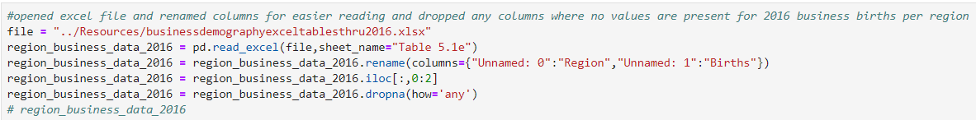
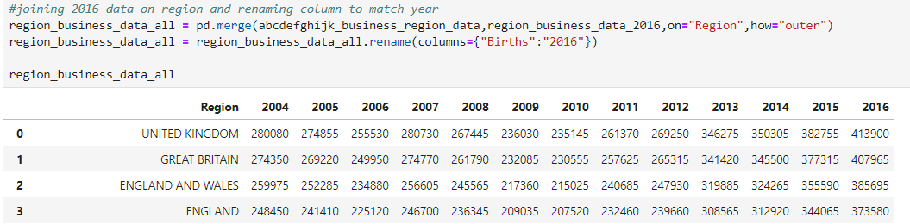
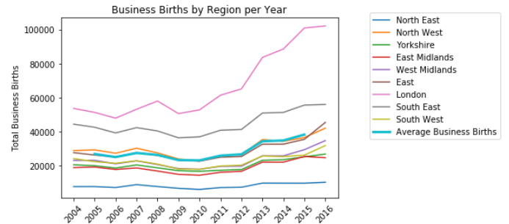
Challenges to Analyzing the Data
Cleaning CSV
Analyzing DataFrames
Visualizing Trends

Slide 6
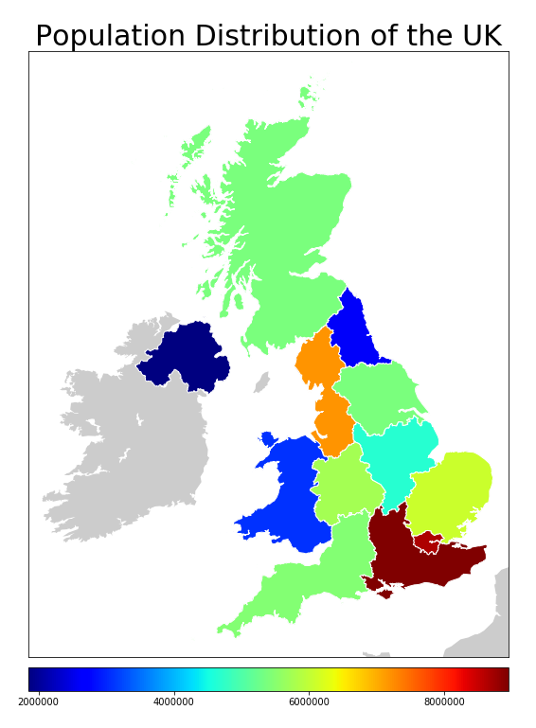
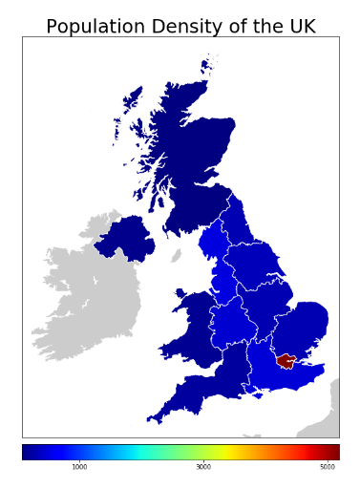
Vote
Is there a correlation between regional population density and vote outcome?
Data Analysis
EU referendum results were compiled into dataframes at the county and regional level
Voting results was cross referenced with 2015 population data and regional sq. km for analysis
Key Findings
The data suggests a correlation exists between rural areas and regions which voted for the EU Referendum
When removing London as an outlier, the data suggests there is a correlation with population density and voting for the EU referendum.
Difficulties
Installing, researching, and learning matplotlib.Basemap
Next Steps
Further statistical analysis would be necessary to confirm causation

Slide 7
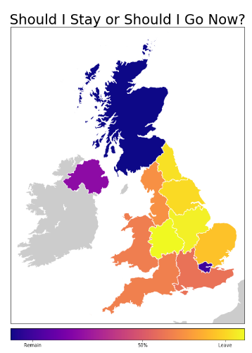
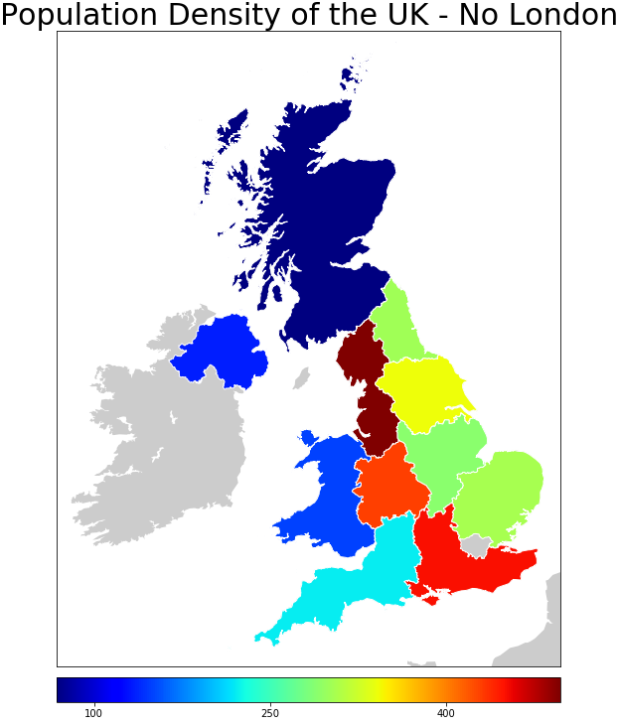
Vote
Is there a correlation between regional population density and vote outcome?

Slide 8
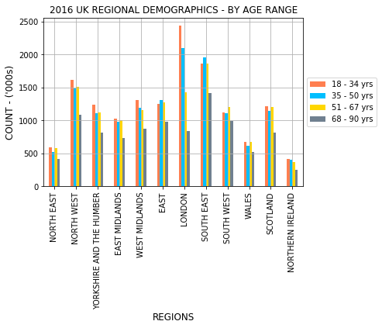
Age by Region
Notes:
Is there a correlation between regions with a strong leave/remain vote and gender?

Slide 9
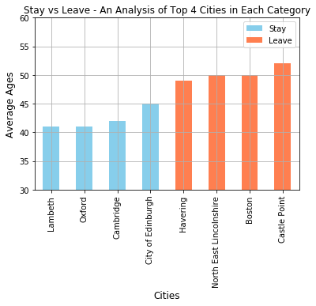
Age by Region
Data Analysis
Set age ranges and create 2016 df
Plot bar chart by region
Compare strong leave/remain regions with significant chart points
Key Findings
Cities with a strong “Stay” vote had lower avg ages & vice versa
London has the greatest no. of young voters
South East has the greatest no. of older voters
London has the greatest no. of young voters (18-50)
Difficulties
Age ranges are subjective (estimated in line with life expectancy)
Formatting of original dataset. Cleaned in excel, then imported
Next Steps
City level analysis
Obtain actual vote data by age to confirm relationship
Links between age and stage of development/key industries by region
Notes:
Is there a correlation between regions with a strong leave/remain vote and age?

Slide 10
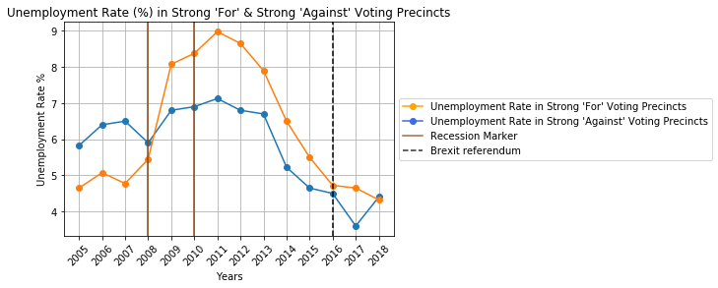
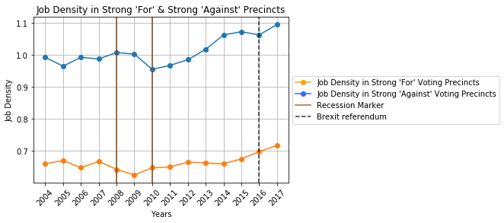
Standard of Living
Is there a discernible difference in standard of living metrics between voting precincts with a strong “For” or strong “Against” Brexit vote?
Data Analysis
Obtained standard of living metrics from the O.N.S. and merged them by precincts that voted strong “For” or “Against”.
Plot to visualize differences, with key markers highlighting trends during the global recession and pre/post Brexit
Key Findings
For” Brexit precincts had higher unemployment rates during the global recession and years leading up to Brexit compared to ‘Against’ Brexit precincts.
Job Density is consistently higher in Precincts that voted “Against” Brexit.
“For” Brexit precincts consistently have a job density less than 1, which indicates more people (ages 16-64) than available jobs.
Difficulties
Original data CSV had extraneous cells that needed removal before importing.
Next Steps
Analyze other Standard of Living metrics (cost of living, income assistance, poverty rate) looking for additional trends.

Slide 11
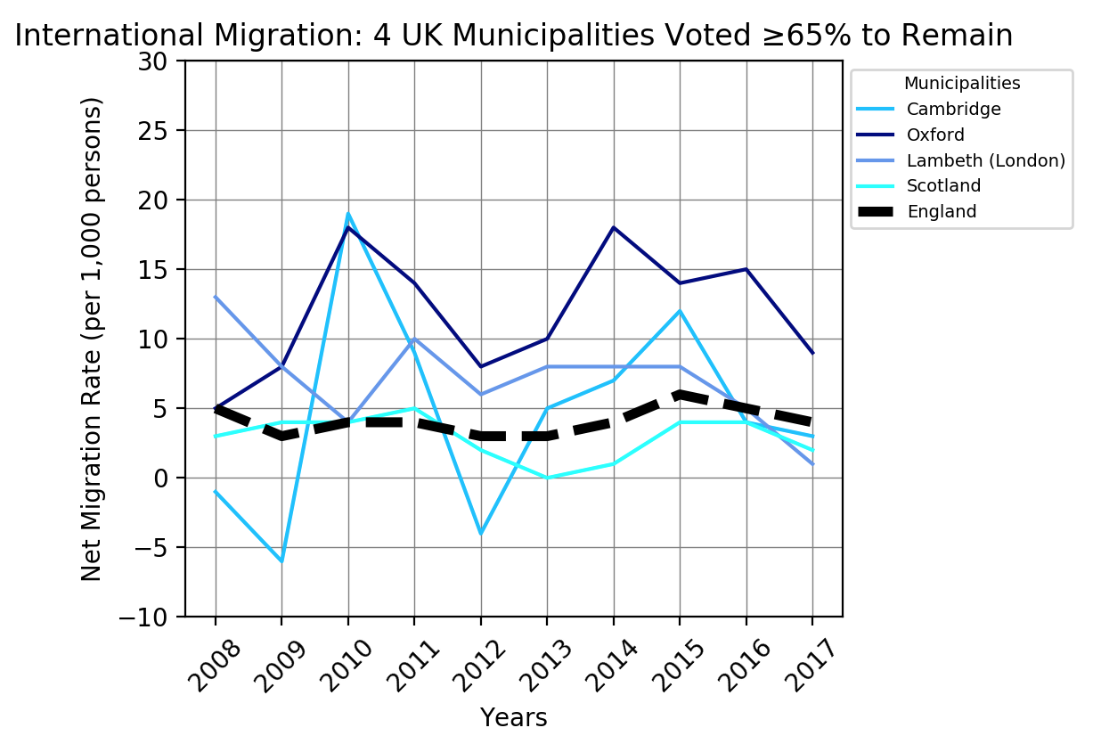
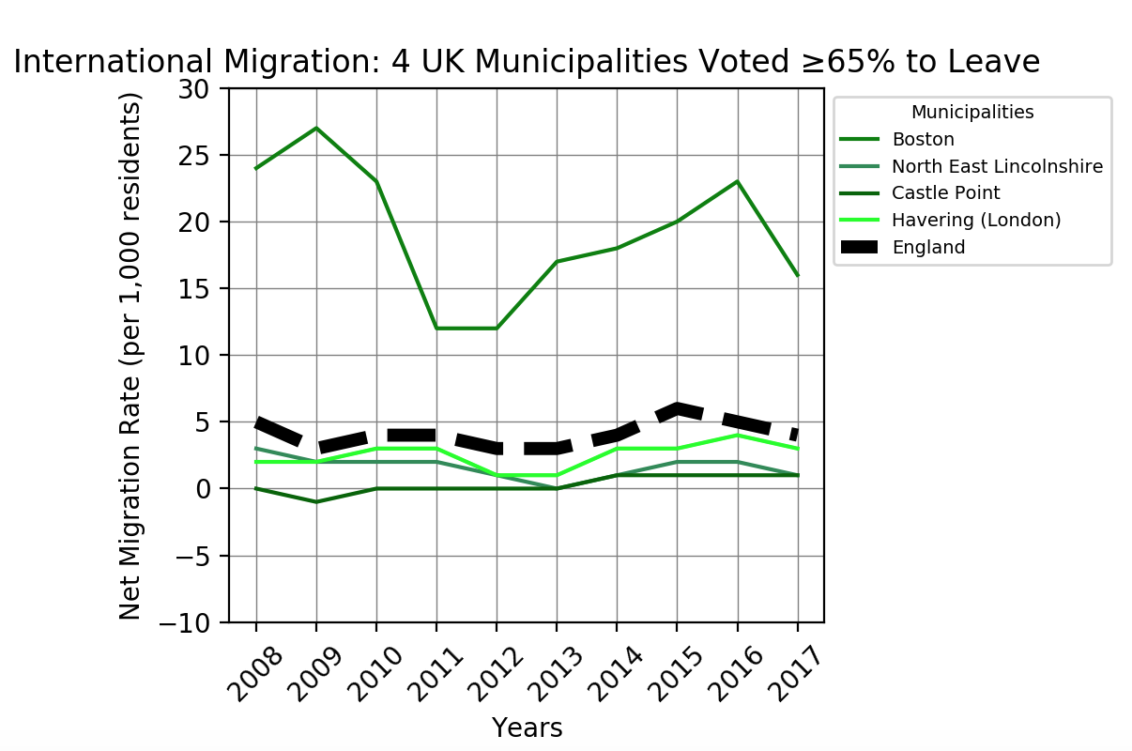
Immigration
Data Analysis
Identified the relevant data to answer the questions in the Long-Term International Migration dataset. Remove irrelevant data from excel sheet.
Calculated the Net Migration Rate using the following equation:
Net Migration= (Immigration-Emigration)/Mid-point Population*1000
Key Findings
Leave: Boston County had the highest percentage vote for leaving the EU and is an outlier among other pro-”leave” counties. Boston was even higher than the highest of the “remain” counties.
Remain: Much more volatility in the net rate of migration over time. 2 counties with large universities (Oxford & Cambridge) had migration trends that were farther from the England average.
Difficulties
Inconsistent availability of data at all levels (country, region, county)
Formatting of the original spreadsheets was not conducive to csv formatting
Determining how to best display the data for a general audience
Next Steps
Combine immigration data set information with business and standard of living information to investigate claims about migration’s role in local economies

Slide 12
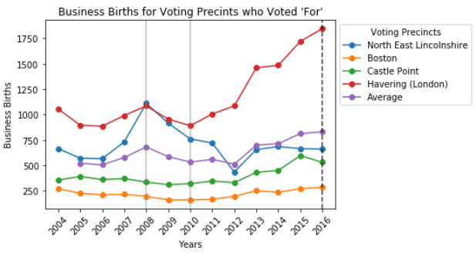
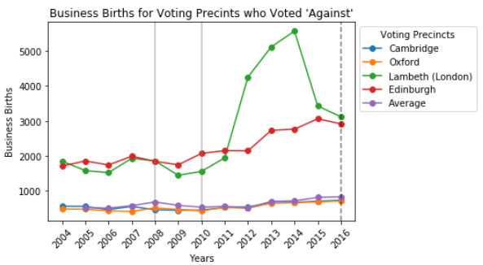
Business
Is the emergence of businesses noticeably different in Voting Precincts that voted to stay vs Voting Precincts that voted to leave?
Data Analysis
Merged business birth data from 2004 - 2016 into dataframe, filtered by region and plotted.
Key Findings
Voting precincts that voted ‘For’ Brexit had a lower number of businesses emerging each year compared to the voting precincts who voted ‘Against’ Brexit.
Drastically different decisions between two voting precincts from the city of London.
Difficulties
Cleaning data between different data sets and having limited amount of data after initial Brexit vote.
Next Steps
Run tests to determine if the samples selected for each voting decision is indicative of population of voting precincts with that same decision.
Continue to upload business birth data for 2017, 2018 and future years to see further trends from Brexit impact.
www.ons.gov.uk/businessindustryandtrade/business/activitysizeandlocation/datasets/businessdemographyreferencetable

Slide 13
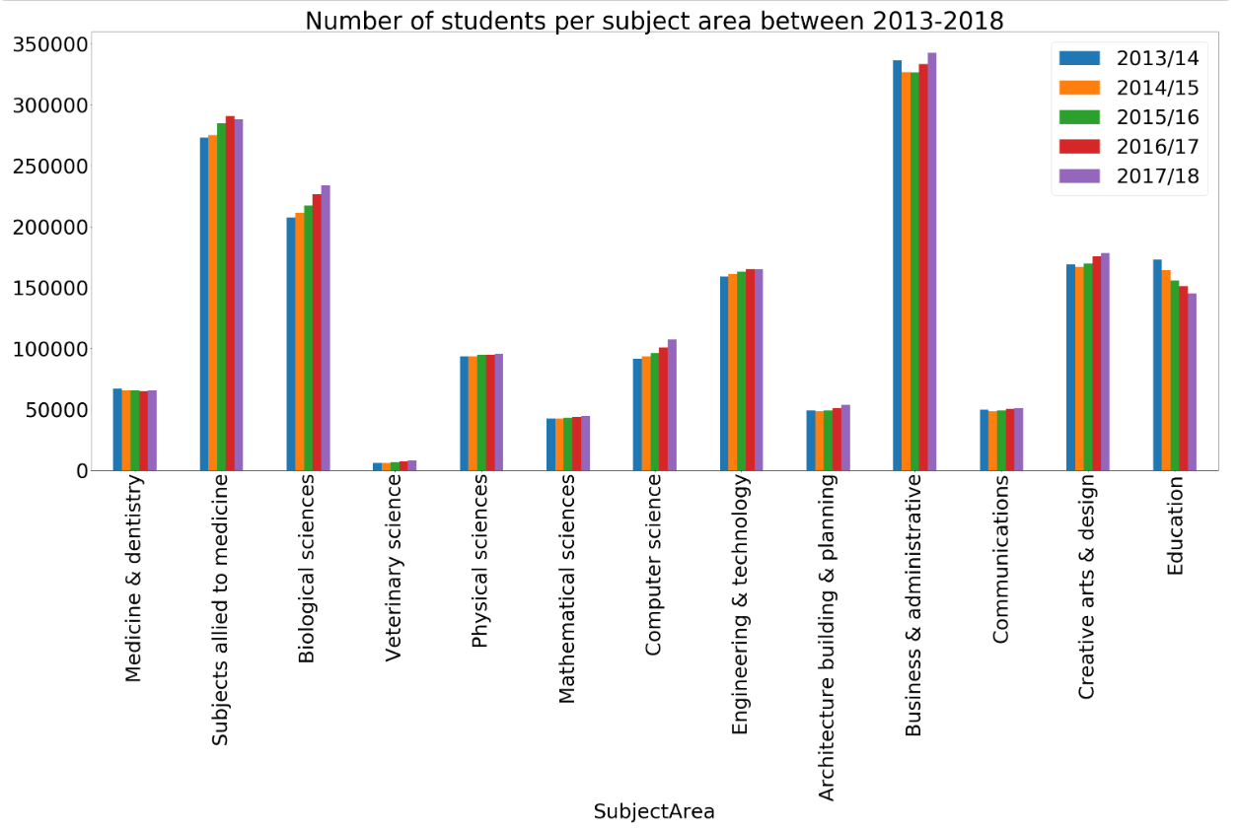
Education
Is there a major shift in terms of subject/major selection among university students between 2013-2018 ?
Data Analysis
Obtained 2013 - 2018 data about major/subject enrollment in UK universities.
Broke data by gender, region, year, level of study, and mode of study (Full time, vs Part time).
Key Findings
Slight increase in number of students who study subjects allied to medicine, Biological sciences, and Computer Science.
Slight decrease of students who study Education related majors
All majors followed a specific trend: increase, decrease, or no noticeable change in terms of number of enrolled students. The only exception was Business and Administrative majors where a decrease followed by no change then an increase in number of enrolled students. The decrease happened during the two years ahead of Brexit vote and started to increase during the Brexit vote year. This could be a reflection to the state of uncertainty during the years of 2014-2015.
Difficulties
Limited number of data. The number of majors is limited.
To measure a trend in any major, data over a long period is required.
Next Steps
Continue to collect and analyse more data sets.
Link the findings to the jobs markets and validate if subject selection in universities is impacted by jobs market.

Slide 14
Reflection & Discussion
Conclusions
There are some discernible differences between areas that voted to leave the EU and areas that voted to stay within the EU. For example:
Precincts that voted “For” Brexit had higher unemployment rates during the global recession and years leading up to Brexit compared to precincts that voted ‘Against’ Brexit.
Voting precincts that voted ‘For’ Brexit had a lower number of businesses emerging each year compared to the voting precincts who voted ‘Against’ Brexit.
Brexit did not cause a major shift in terms of selection of subjects/majors among university students. However, some trends can be noticed.
Regions with strong “Remain” votes, had a lower average age than regions with strong “Leave” votes.
3 of 4 “Leave” counties had net immigration rates below average for England. 2 of 4 “Remain” counties contain large universities and had much more volatility in net migration rates.
Discussions and Challenges:
More accurate conclusions need data across different domains. For example data that shows the income, employment state, gender, education, and major of those who voted For vs those who voted against will show more rich analysis. This was a challenge, due to lack of this data.
Scope creep
Learning new techniques such as Maps in Python.
Data formatting and modeling

Slide 15
Questions

Slide 16
Appendix

Slide 17
Citations
“Dataset: Business Demography, UK.” Office for National Statistics, Office for National Statistics, 21 Nov. 2018, www.ons.gov.uk/businessindustryandtrade/business/activitysizeandlocation/datasets/businessdemographyreferencetable.
“Dataset: “Local area migration indicators, UK, Office for National Statistics, Office for National Statistics, 23 Aug. 2018, https://www.ons.gov.uk/peoplepopulationandcommunity/populationandmigration/migrationwithintheuk/datasets/localareamigrationindicatorsunitedkingdom
Experts in UK higher education data and analysis https://www.hesa.ac.uk/data-and-analysis/students/what-study

Slide 18
Appendix - 1a

Slide 19
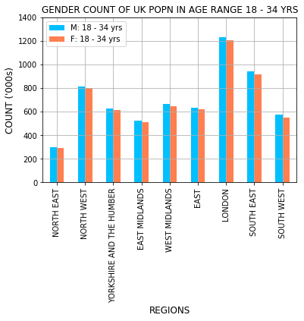
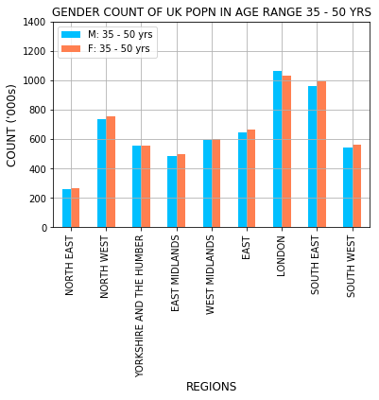
Appendix - 1b

Slide 20
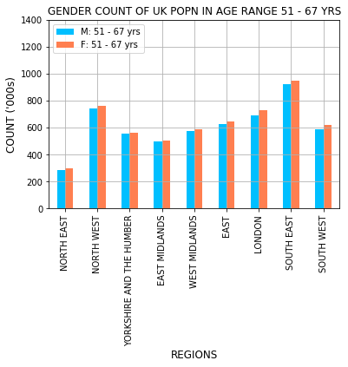
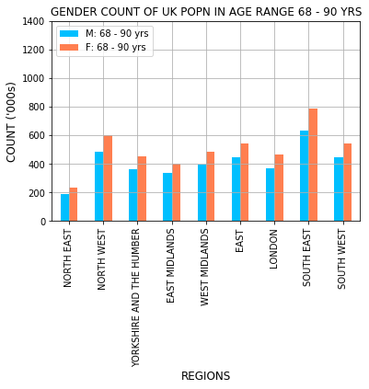
Appendix - 1c

Slide 21
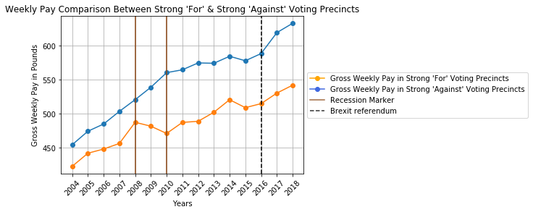
Appendix-1d

Slide 22
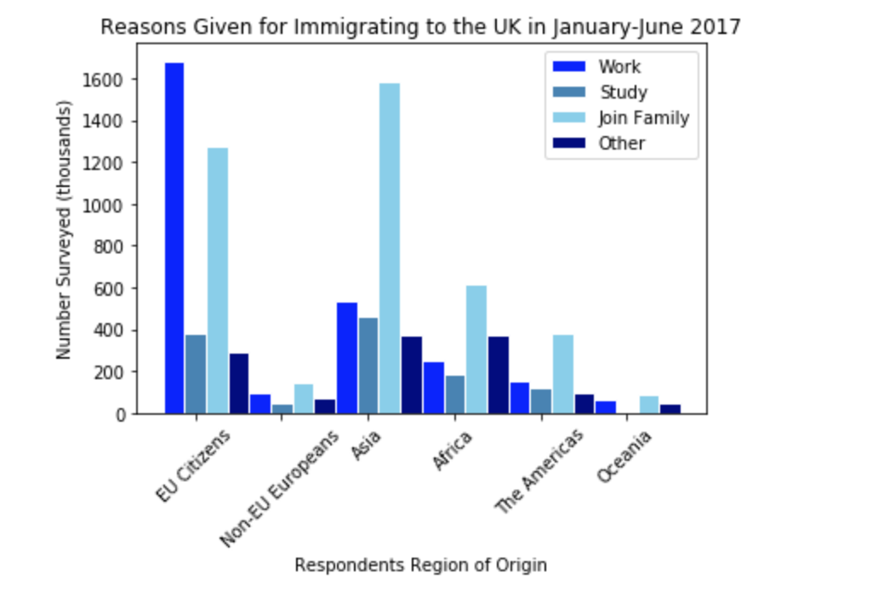
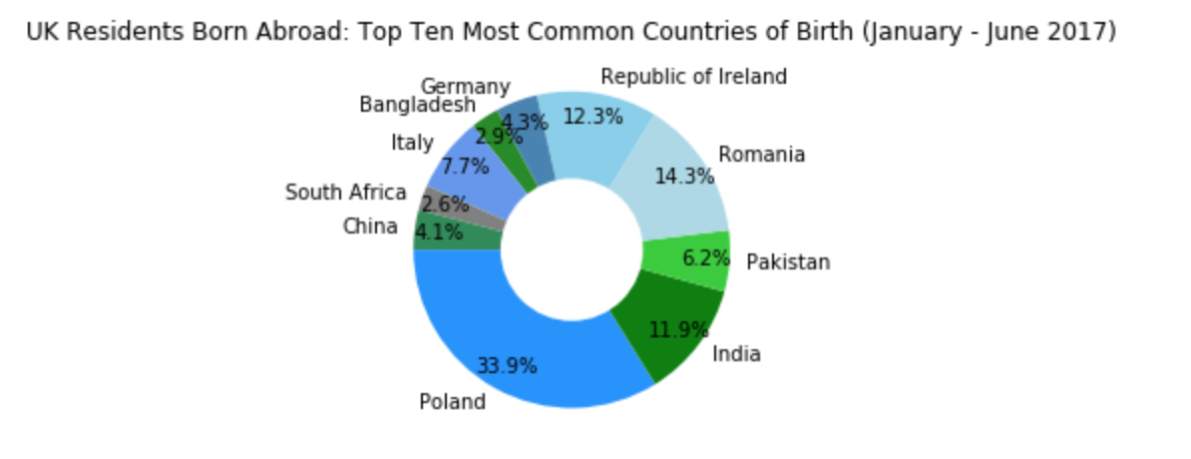
Appendix-1e

